Slide 1


Walther Glodstaf
29th of June 2023
Overall Git Repository: https://github.com/Wallekish/IBM-DS-Capstone-Coursera-

Slide 2

Outline
Executive Summary
Introduction
Methodology
Results
Conclusion
Appendix

Slide 3
Executive Summary
Methodologies
Data collection through webscraping and API
Data was cleaned to remove null values and eliminate rockets with more than one booster, and convert values into usable formats (dates, booster version, launchpad names etc.)
Finally data was filtered to only include Falcon 9 launches
Exploratory Data Analysis (EDA) with SQL and Data Visualisation
Visualisation was further made interactive via Folium
Machine Learning Predictions
Summary of all results
Success rate increases with each launch and year, but higher payload decrease launch success independently of this.
Launch site success rate is between 60% and 77%
ES-L1, GEO, HEO, SSO, and VLEO orbits have a high success rate but for heavy payloads Polar, LEO and ISS landings are more successful.

Slide 4
Introduction
Background
Falcon 9 rockets have a major cost saving potential for commercial space flight si nce the first stage of the launch can be re-used. Cost savings are over 100 million USD compared to competitors where the first stage cannot be re-used, however, the cost-saving potential hinges on understanding the factors that allow for the first stage to be re-used, and how this can be made even cheaper.
Research Question
What factors predict whether the first stage of Falcon 9 can be re-used, both those inherent to the first stage (such as booster type and payload) and those external to it (such as launch site)?

Slide 5

Section 1

Slide 6
Methodology
Executive Summary
Data collection methodology:
Webscraping (Wikipedia) and API (SpaceX)
Perform data wrangling
Only data until November 13th, 2020. Using the Falcon 9 with one booster was considered. Null values were eliminated.
Perform exploratory data analysis (EDA):
Visualisation of the Data and SQL queries.
Interactive visual analytics using Folium and Plotly Dash
Perform predictive analysis using classification models
Variables for Model building were selected based on EDA. Categorical variables were one-hot encoded. Logistic regression, KNN, decision tree, SVM, were then compared based on accuracy.

Slide 7
Data Collection
Data was collected via the SpaceX API and web scraping from Wikipedia for launch records.
Data was filtered for relevant characteristic in terms of launch date, only Falcon9 launches, and only rockets using one booster.
Data was then converted into a pandas dataframe.

Slide 8
Data Collection – SpaceX API
Get requests were used to collect data from the SpaceX API, which was then cleaned, wrangled and formatted according to the flowchart.
URL: https://github.com/Wallekish/IBM-DS-Capstone-Coursera-/blob/main/jupyter-labs-spacex-data-collection-api.ipynb
Get data from API based on variables of interest (Booster version, cores, Launch Site, and Payload)
↓
Clean data with get functions to get usable names for variables of interest if none were in raw data
↓
Create a new dataset with the cleaned data. And filter again.

Slide 9
Data Collection - Scraping
Scrape Data from Wikipedia and convert it into a pandas dataframe
URL: https://github.com/Wallekish/IBM-DS-Capstone-Coursera-/blob/main/jupyter-labs-webscraping.ipynb
Get data from Wikipedia
↓
Read in HTML Table
↓
Parse HTML Table into a new pandas dataframe

Slide 10
Data Wrangling
Data set was checked for
Variable types
Missing values
Data set was cleaned
Replacing numerical missing values with means
Outcome label was transformed into a binary instead of multivariate categorical variable
URL: https://github.com/Wallekish/IBM-DS-Capstone-Coursera-/blob/main/labs-jupyter-spacex-Data%20wrangling.ipynb

Slide 11
EDA with Data Visualization
Charts were plotted based on exploring relationships between variables of interest:
Flight number and success
Year and success
Payload and success
Launch Site and success
Orbit and success
Orbit and payload
URL: https://github.com/Wallekish/IBM-DS-Capstone-Coursera-/blob/main/edadataviz.ipynb

Slide 12
EDA with SQL
Performed SQL queries:
Unique launch site name
Total Payload mass for booster’s by NASA (CRS)
Avg payload mass carried by booster f9 v1.1
Total number of successful/failed missions
Booster version and launch site for failed drone ship landings
URL: https://github.com/Wallekish/IBM-DS-Capstone-Coursera-/blob/main/jupyter-labs-eda-sql-coursera_sqllite.ipynb

Slide 13
Build an Interactive Map with Folium
Map objects
Markers: success rates for each lauch site (colour coded)
Circles: launch sites and individual launches
Lines: to coast, city, highway and railroad
Each of these allows to identify shared geographical markers or launch site to determine what makes a good launch site.
Success rate can define what a bad/good launch site is.
URL: https://github.com/Wallekish/IBM-DS-Capstone-Coursera-/blob/main/lab_jupyter_launch_site_location.ipynb

Slide 14
Build a Dashboard with Plotly Dash
Dashboard plots:
SpaceX Launch success records as a pie chart (all sites and individual sites)
Correlation between Payload and success for all sites (scatterplot)
Success rates can help identify particular launch site factors that are important
While correlations between booster version and payload and launch site can help visualize the relationship between launch site the launch site variables and the booster/specific variables
URL: https://github.com/Wallekish/IBM-DS-Capstone-Coursera-/blob/main/spacex_dash_app.py

Slide 15
Predictive Analysis (Classification)
Data was test into test and training set
Models were built for: Logistic Regression, KNN, SVM, and Decision tree
Models were tuned using feature engineering and algorithm tuning based on the confusion matrix.
Accuracy was used to compare models
URL: https://github.com/Wallekish/IBM-DS-Capstone-Coursera-/blob/main/SpaceX_Machine%20Learning%20Prediction_Part_5.ipynb

Slide 16
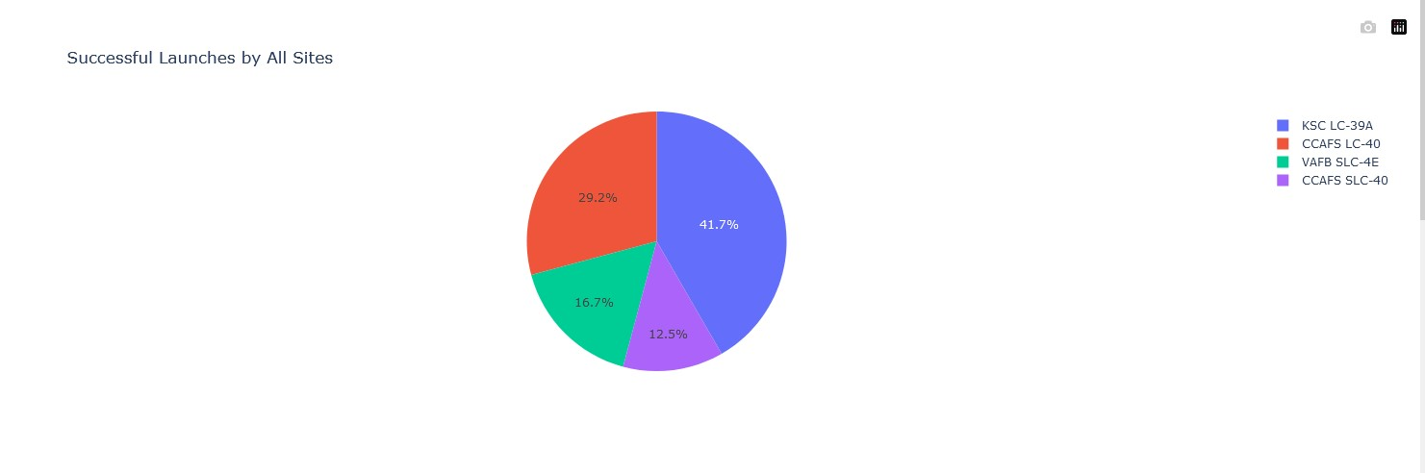
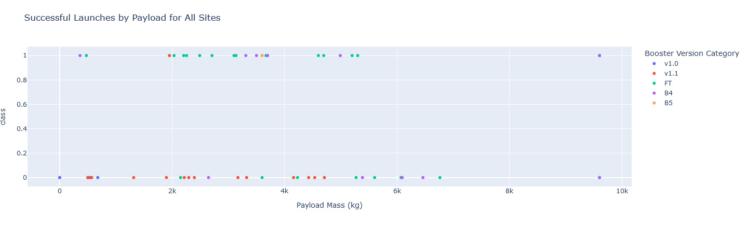
Results
EDA Results:
Success rate increases with each launch and year, but higher payload decrease launch success independently of this.
Launch site success rate is between 60% and 77%
ES-L1, GEO, HEO, SSO, and VLEO orbits have a high success rate but for heavy payloads Polar, LEO and ISS landings are more successful.
Interactive analytics (see screenshots)
No model is significantly more accurate than another. Concern for false positives.

Slide 17

Section 2

Slide 18
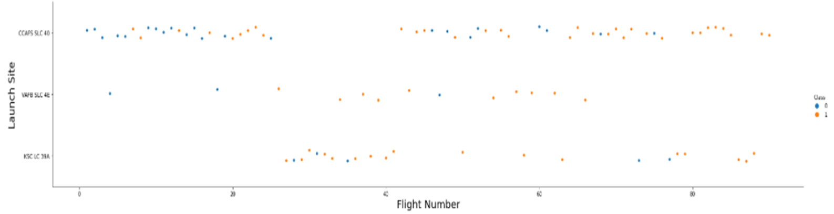
Flight Number vs. Launch Site
Success increases with number of launches for each site.

Slide 19
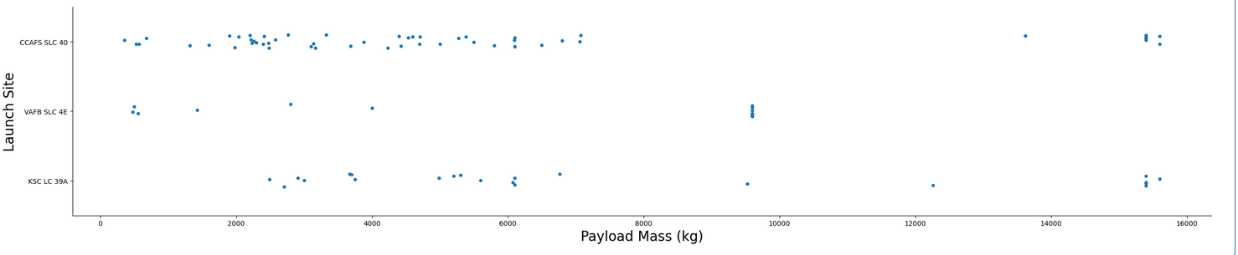
Payload vs. Launch Site
VAFB SLC 4E seems to have a higher cap on payload mass than the other launch sites.

Slide 20
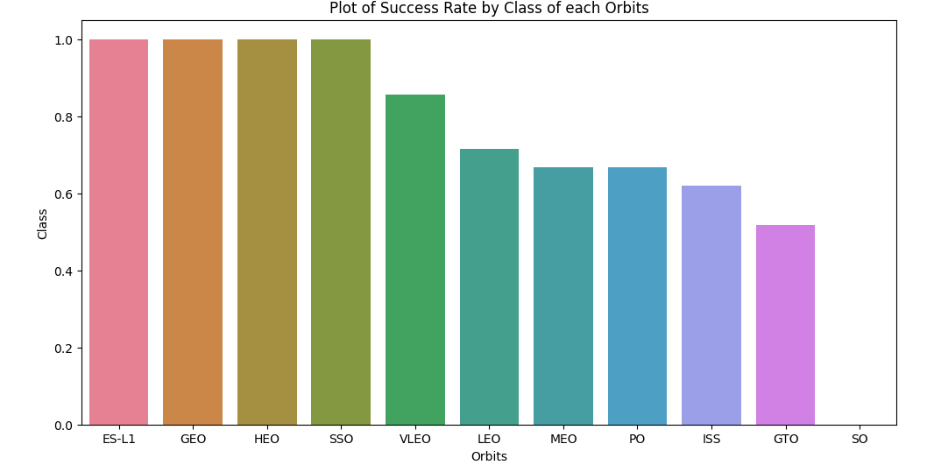
Success Rate vs. Orbit Type
ESL-1, GEO, HEO, and SSO have a 100% success rate.
VELO is somewhat above chance
Others are around 60%

Slide 21
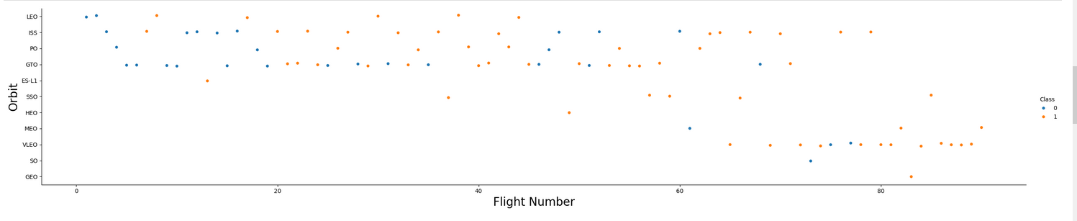
Flight Number vs. Orbit Type
Number of flight is not correlated by orbit type as far as success rate is concerned.
However, less flights seems to broadly indicate more success, particularly for LEO.

Slide 22
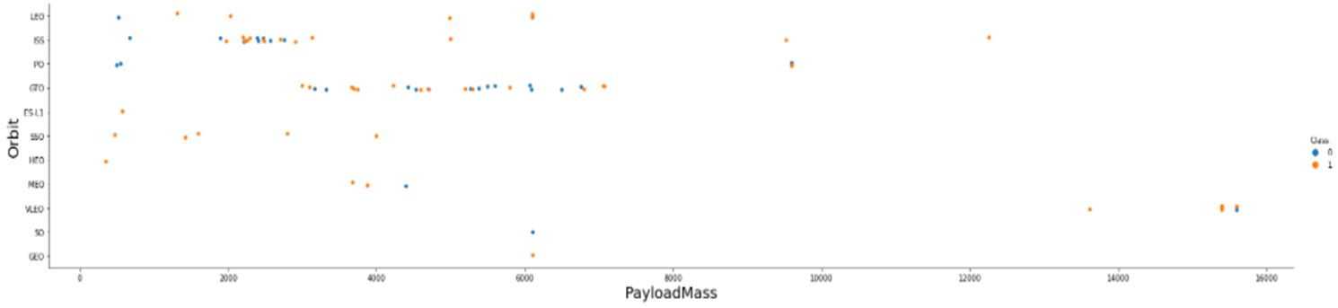
Payload vs. Orbit Type
Polar, LEO and ISS missions with higher payload show increasing success with greater mass compared to other missions.
No clear trend for GTO missions.

Slide 23
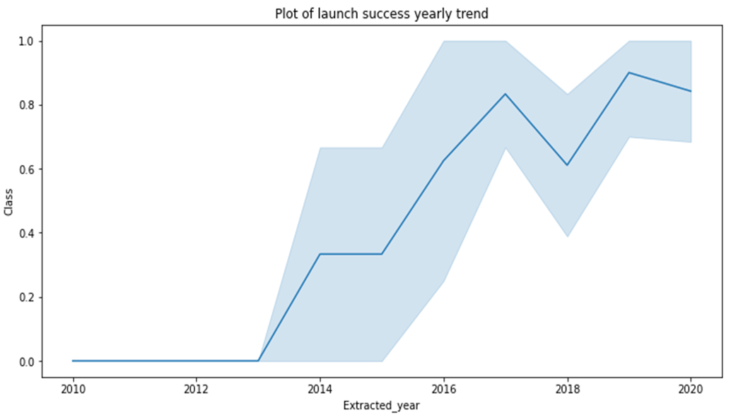
Launch Success Yearly Trend
Success rate increases with every year, indicating increased knowledge.
To compete in price competitors, need to close knowledge gap fast.

Slide 24
All Launch Site Names
Launch Site names retrieved with DISTINCT:
KSC LC-3A
CCAFS LC-40
CCAFS SLC-40
VAFB SLC-4E

Slide 25
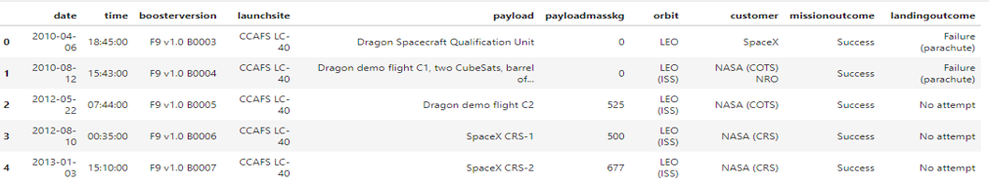
Launch Site Names Begin with 'CCA'
5 records from launch sites that begin with CCA.
We see that CCAFS LC-40 comes first here due to alphabeitisation

Slide 26
Total Payload Mass
Total payload carried by boosters from NASA: 45596kg
Calculates as SUM of PayloadMassKG from DATA where Customer had the string NASA (CRS).

Slide 27
Average Payload Mass by F9 v1.1
Average payload mass carried by booster version F9 v1.1: 2928.4kg
Calculated as AVG of PayloadMassKG where Booster version equals F9 v1.1

Slide 28
First Successful Ground Landing Date
First successful landing outcome on ground pad: 2015/12/22

Slide 29
Successful Drone Ship Landing with Payload between 4000 and 6000
Names of boosters which have successfully landed on drone ship and had payload mass greater than 4000 but less than 6000:
F9 FT B1022
F9 FT B1026
F9 FT B1021.2
F9 FT B1031.2
Booster Version was filtered based on successful landing on a drone ship if it had a mass between 4000 and 6000 kg.

Slide 30
Total Number of Successful and Failure Mission Outcomes
Total number of successful missions: 100
Total number of failed missions: 1
Based on filtering Mission Outcomes that included Success (and a wildcard) or did not so so.

Slide 31
Boosters Carried Maximum Payload
Names of the booster which have carried the maximum payload mass:
F9 B5 B1048.4 F9 B5 B1049.4 F9 B5 B1051.3 F9 B5 B1056.4
F9 B5 B1048.5 F9 B5 B1051.4 F9 B5 B1049.5 F9 B5 B1060.2
F9 B5 B1058.3 F9 B5 B1051.6 F9 B5 B1060.3 F9 B5 B1049.7

Slide 32
2015 Launch Records
List the failed landing_outcomes in drone ship, their booster versions, and launch site names for in year 2015
Only 2 failed drone ship landings were registered in 2015.
01 | F9 v1.1 B1012 | CCAFS LC-40 | Failure (drone ship)
04 | F9 v1.1 B1015 | CCAFS LC-40 | Failure (drone ship)

Slide 33
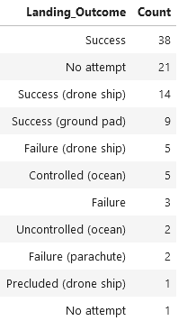
Rank Landing Outcomes Between 2010-06-04 and 2017-03-20
Count of landing outcomes (such as Failure (drone ship) or Success (ground pad)) between the date 2010-06-04 and 2017-03-20, in descending order

Slide 34

Section 3

Slide 35
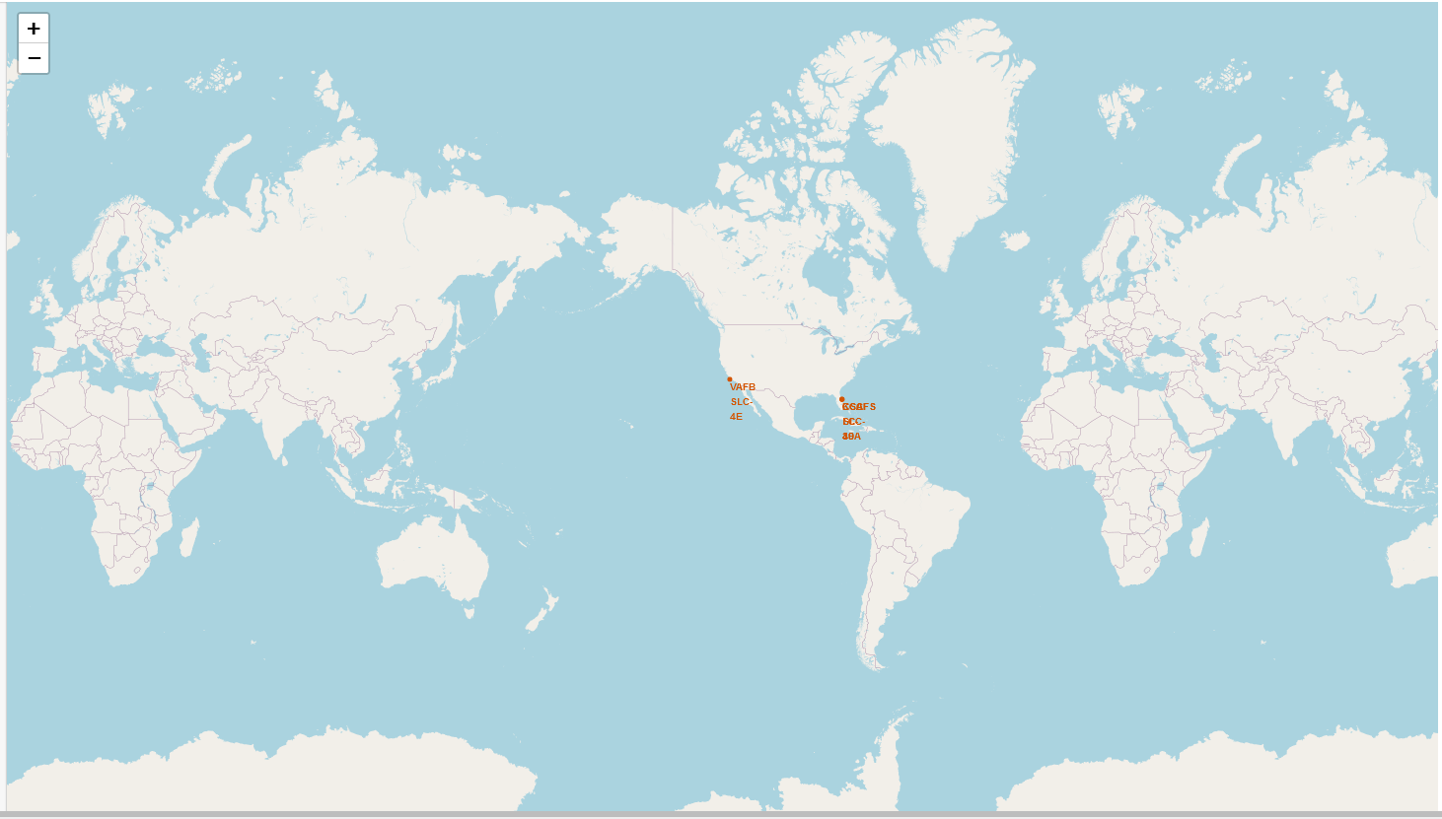
Launch Site Locations
Launch sites are all located:
On the coast
In the US
As close to the equator as possible (in the US)

Slide 36
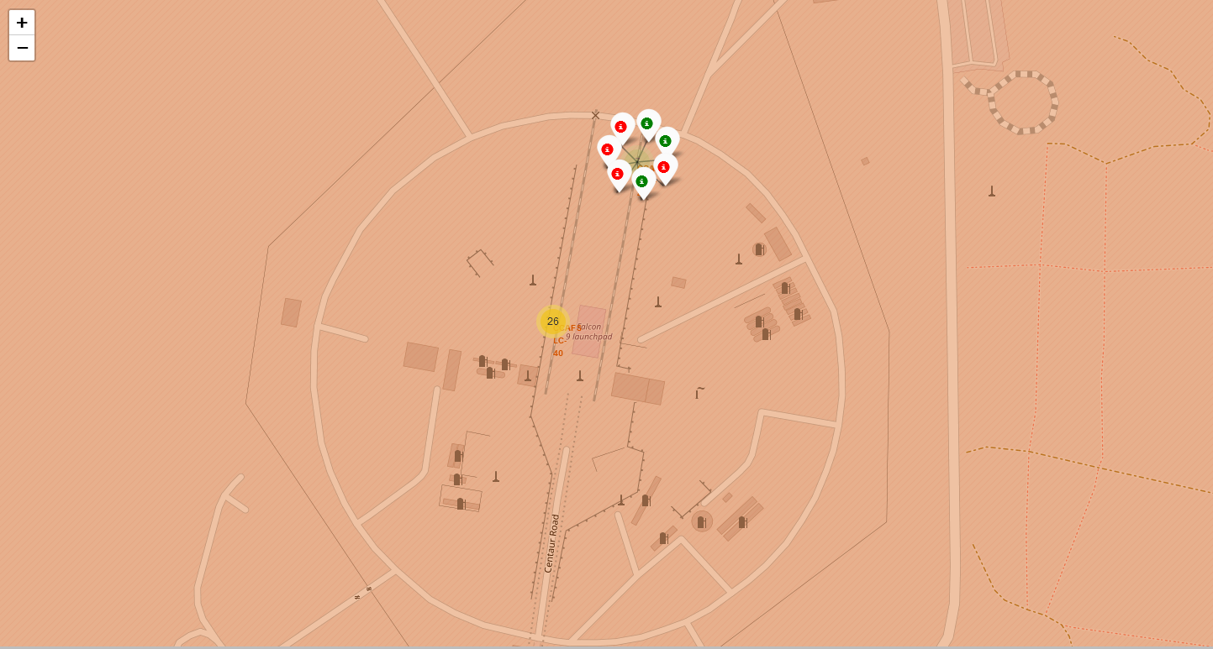
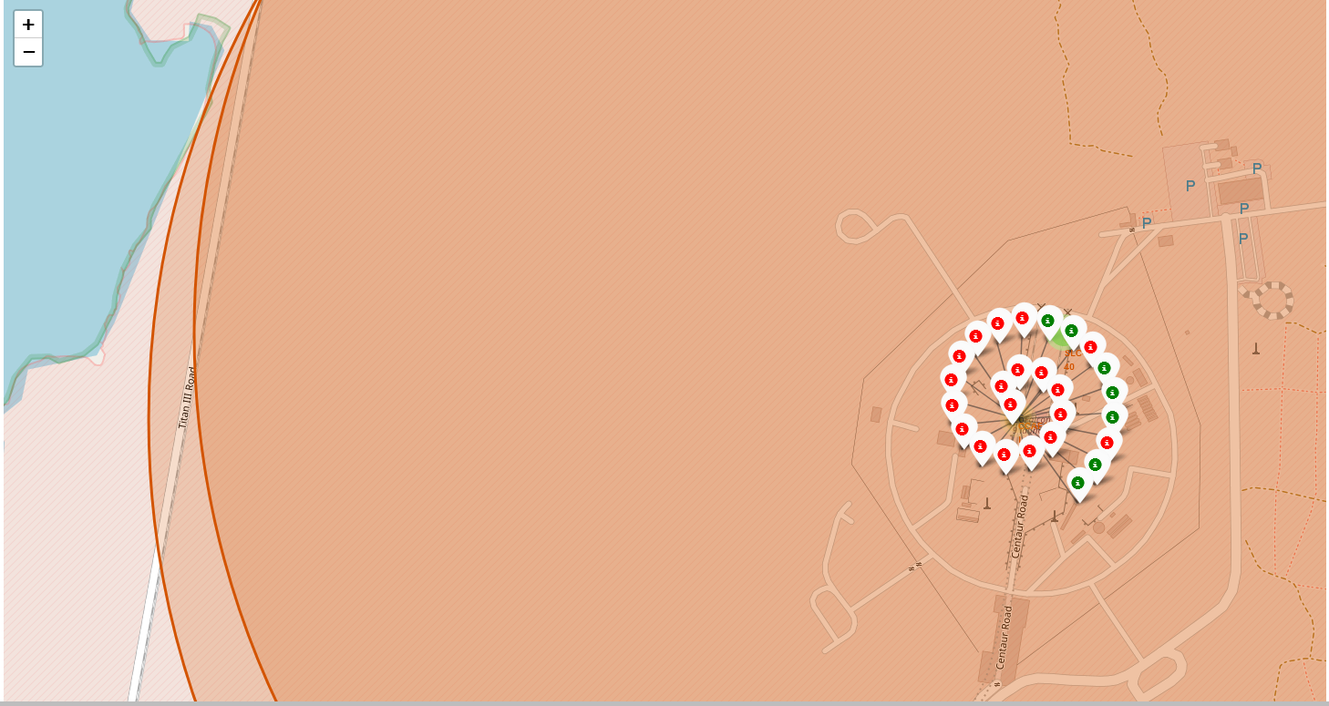
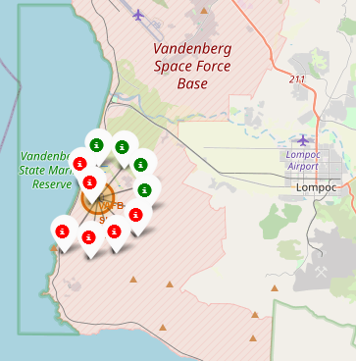
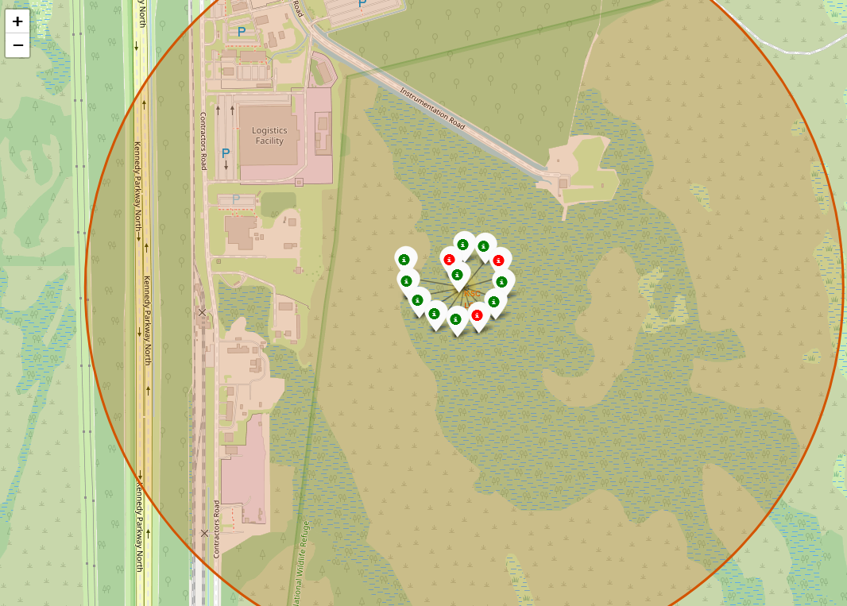
Launch Outcomes
Successful launches (green) and failed launches (red).
Site CCAFS SLC-40
Site CCAFS LC-40.
Site VAFB SLC-4E
Site KSC LC-39A

Slide 37
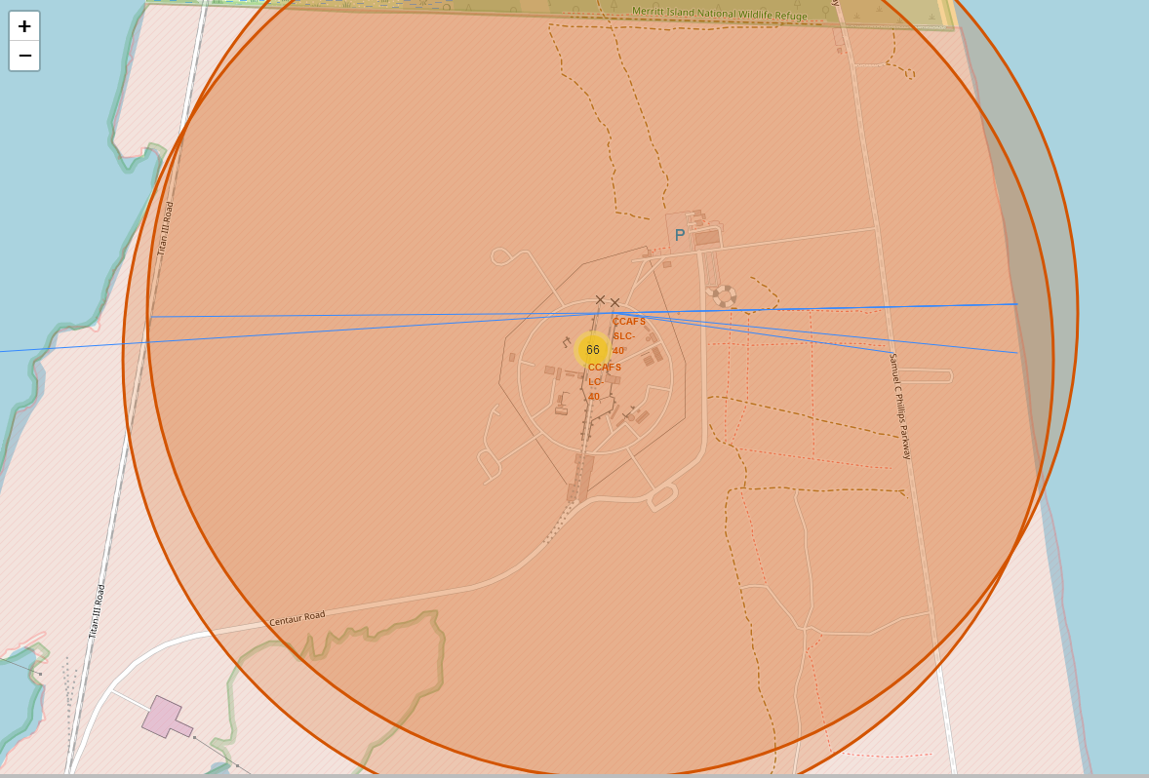
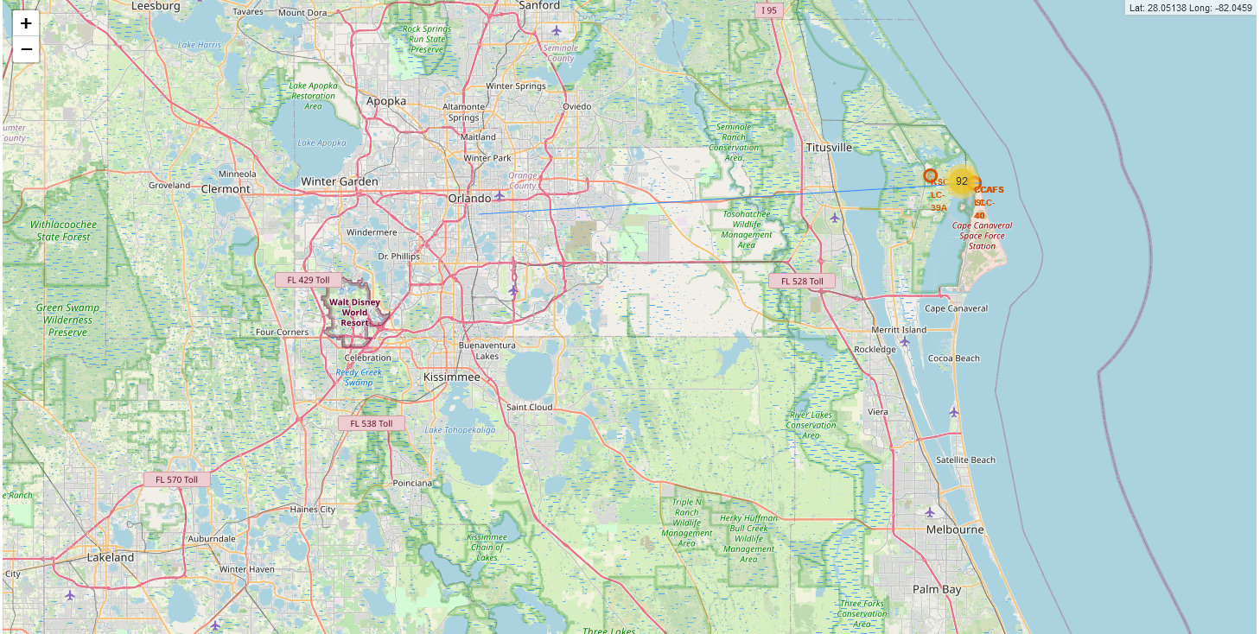
<Folium Map Screenshot 3>
Launch sites are far from cities.
Distance to railroads and highways is also kept in mind, while closeness to the coast is prioritized.

Slide 38

Section 4

Slide 39
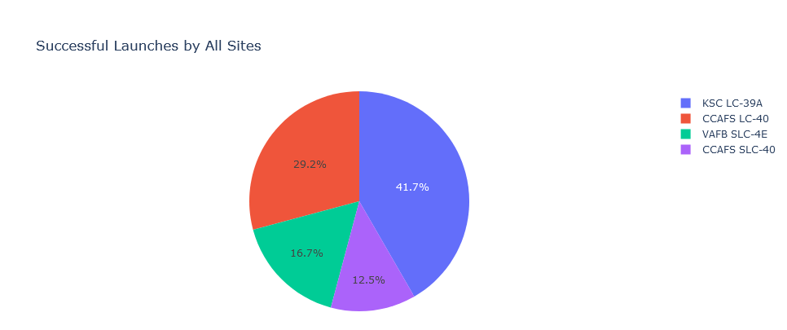
Launch Success Rates for All Sites
Site KSC LC-39A has the most amount of successful launches
Site VAFB SLC-4E has the least amount of successful launches.
Numbers are somewhat skewed by non-uniform launch numbers per site.

Slide 40
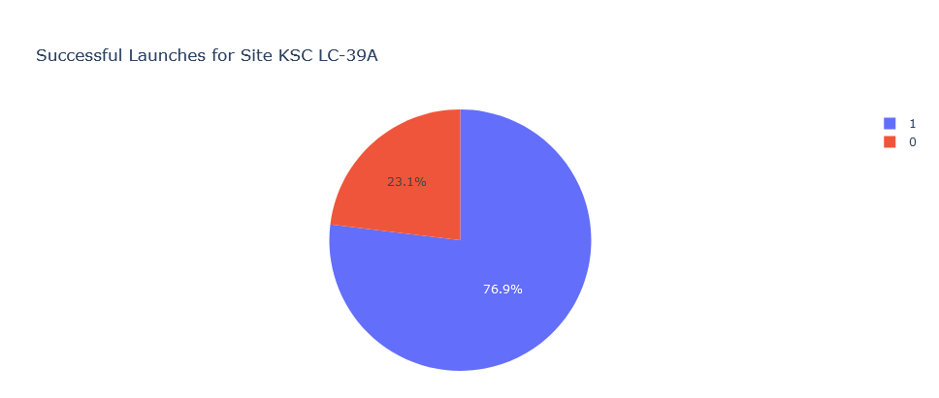
KSC LC-39A Launch Success Ratio
Launch success coded as 1 and failure as 0
Launch Success Ratio well over chance.
Potentially because KSC staff and site has seen use since the dawn of the space race, reflecting experience.

Slide 41
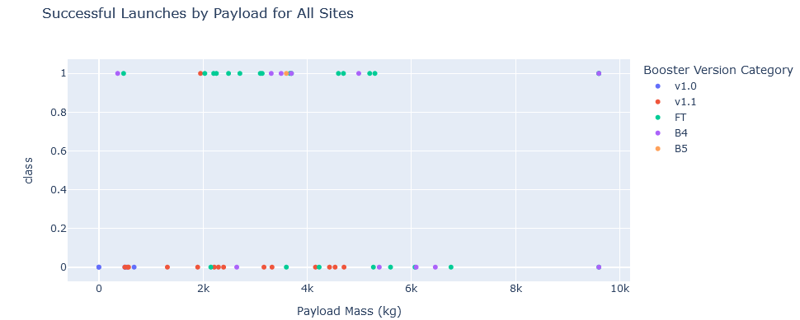
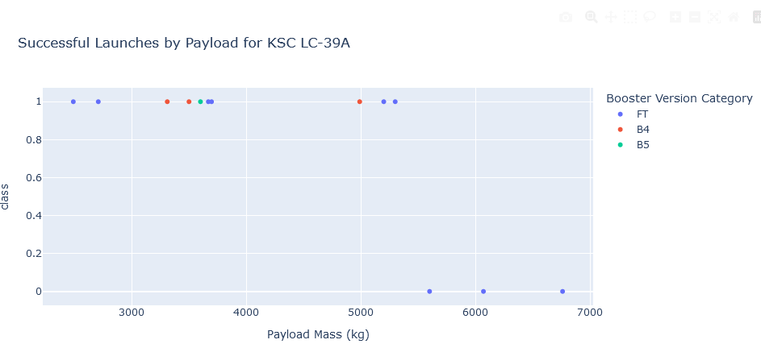
Launch Success, Payload Mass, and Booster Version
Launch success is guaranteed below 5000kg payload for all boosters
Only Booster that has done higher payloads is FT, Success chance is only at 50% for payloads of 5500kg and 0% for higher than that
This is true even for the most successful launch site.

Slide 42

Section 5

Slide 43
Classification Accuracy
All models had the same accuracy and confusion matrix.

Slide 44

Confusion Matrix
Models can accurately identify true positive, and true negatives.
False negatives do also not happen
But there are false positives, which is a concern, indicating the model is not conservative enough.

Slide 45
Conclusions
Success rate increases with each launch and year, but higher payload decrease launch success independently of this.
Launch site success rate is between 60% and 77%
ES-L1, GEO, HEO, SSO, and VLEO orbits have a high success rate but for heavy payloads Polar, LEO and ISS landings are more successful.

Slide 46
Appendix
All code and notebook can be found at: https://github.com/Wallekish/IBM-DS-Capstone-Coursera-

Slide 47


